Slide 1
DARP Algorithm

Slide 2
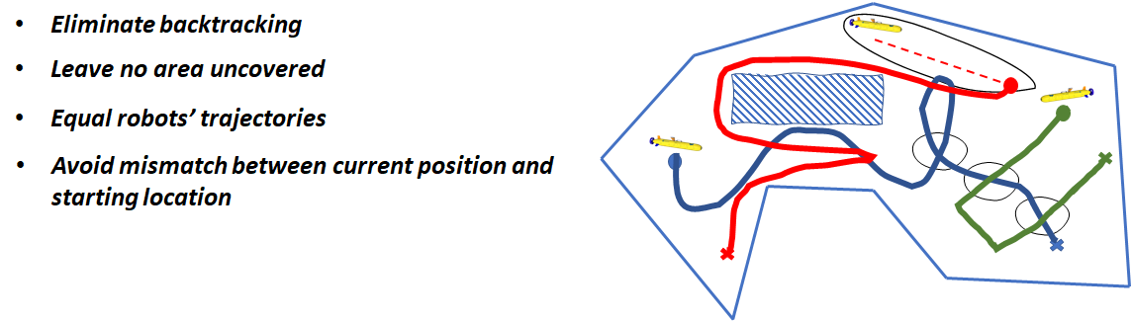
Objective
Design robot paths that completely cover this area of interest in the minimum possible time called coverage path planning problem (CPP).

Slide 3
Basic Building Blocks
Cellular decomposition
Firstly we need to represent our area of interest into small blocks.
Therefore, one of the most common areas representation techniques is to separate the field into identical cells (e.g. in the size of the robot), such that the coverage of each cell can be easily achieved
Spanning tree coverage (STC)
One of the dominant approaches to solve single robot coverage planning problem.
It is based on constructing a minimum spanning tree on the already cellular decomposed region.

Slide 4
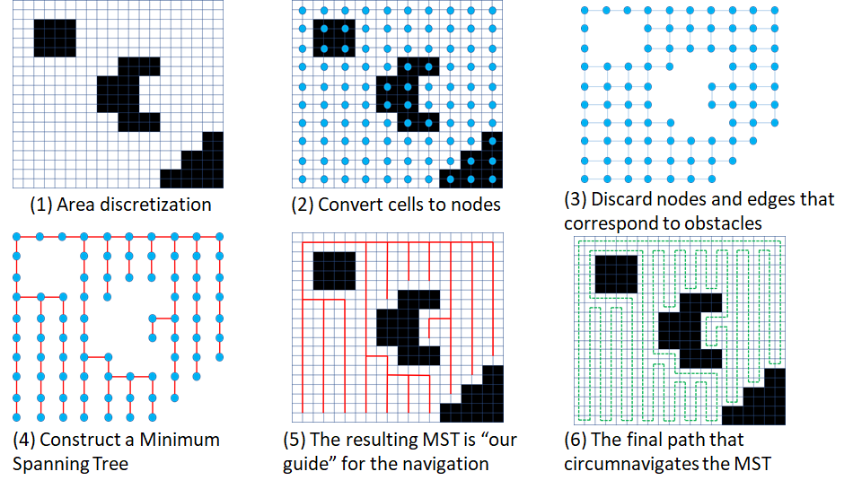
Basic Building Blocks

Slide 5
mCPP (multiple CPP) and DARP
STC method can be used however, final solution is highly dependent on the initial positions of the robots and results in uneven robot trajectories.
So, the main idea of DARP (Divide Areas based on Robot’s Initial Positions) is to apply STC individually for each robot by first assigning a certain area of the map to each robot.

Slide 6
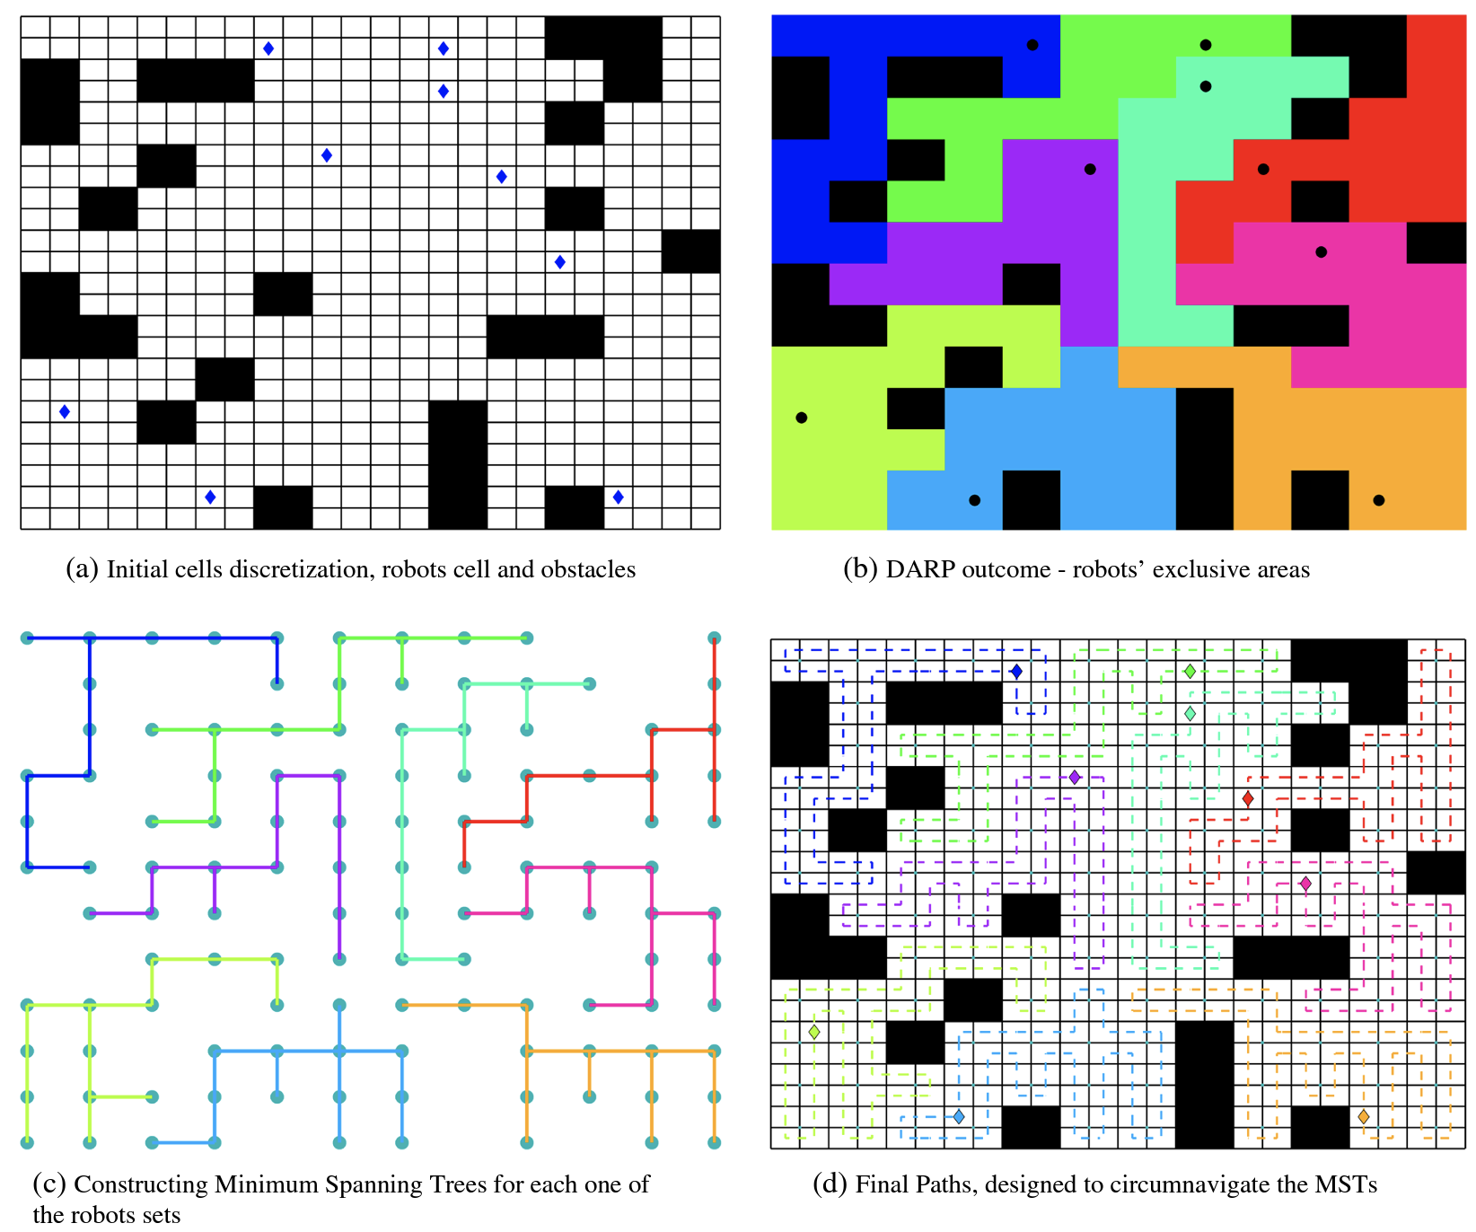

Slide 7
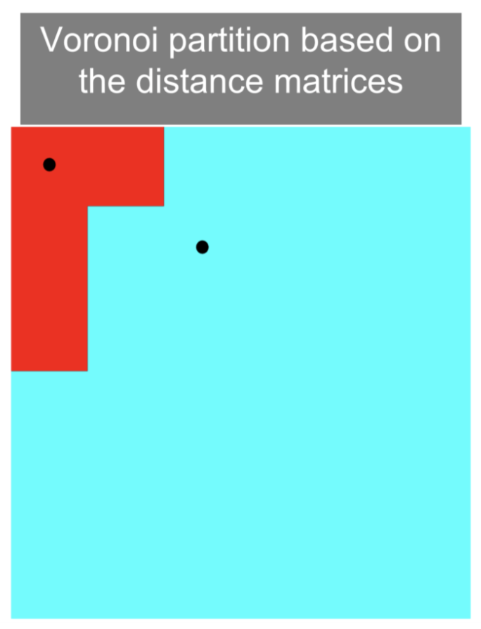
How to assign regions ?
Again the most natural way seems to use the idea of Voronoi partitioning, i.e. assign a block to the robot with the closest initial position.
However, if we use this method, we again run into the problem where the area
that each bot covers becomes dependent on the initial position of each bot.
We can basically use the concept of error control, i.e. in case the area of a bot is lesser
than what it is supposed to be, we reduce its ‘distance’ to all cells so that more are
now assigned to that robot, and similarly, for robots which have higher area,
we increase their ‘distance’.

Slide 8
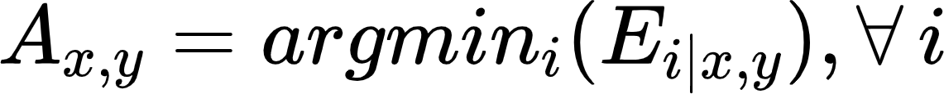

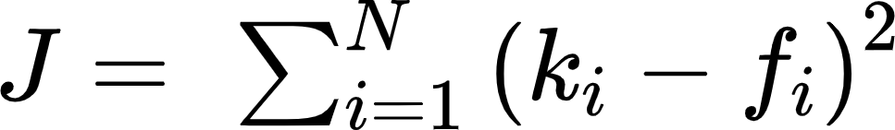
DARP 0.5
For every ith operational robot, an evaluation matrix Ei is maintained. This evaluation matrix Ei expresses the level of reachability (e.g. distance) between the cells of L (the map) and ith robot’s initial position xi(t0).
Let the values of the matrix Ei be initialised with some distance metric (e.g., Euclidean distance). Now, as mentioned earlier, the DARP algorithm’s core idea is that each evaluation matrix Ei can be appropriately “corrected” by a term mi as follows:
Error Function for each robot,
Where ki denotes the number of assigned cells to the ith robot, while fi denotes the number of cells that the ith bot has to cover.

Slide 9
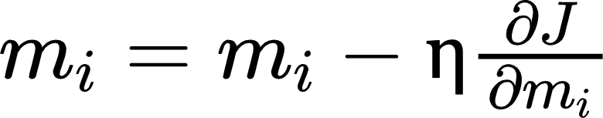
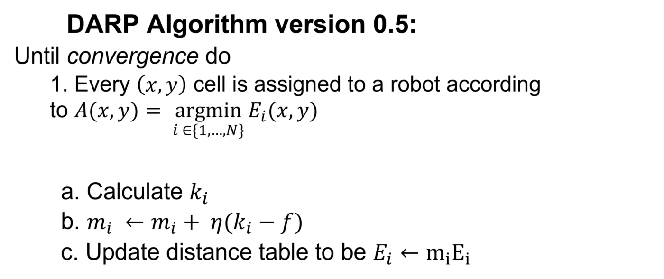
Iterative Gradient Descent on mi
Now, depending on the value of J for each robot, we can change the value of miappropriately for all robots by using a standard gradient descent method,

Slide 10
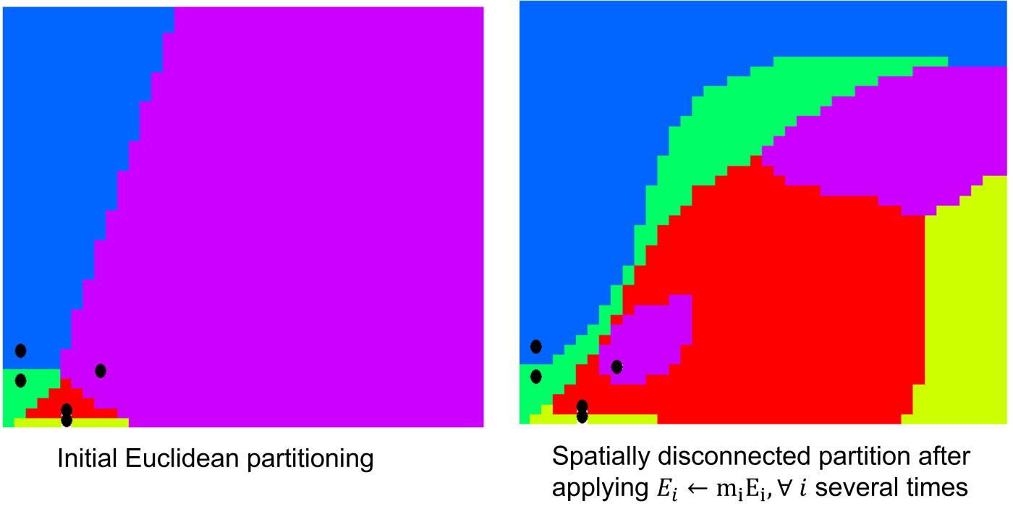
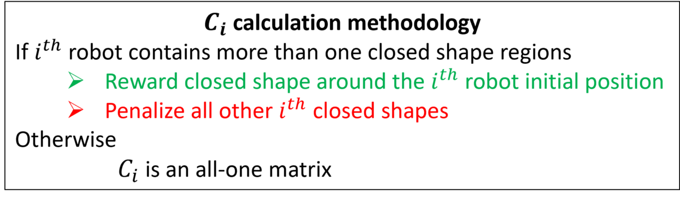
DARP 1.0
Spatial Disconnectivity problem:
This phenomenon is due to the fact that now the metric function for each robot, over which the assignment process is implemented, is no longer a distance function.
To tackle this issue, an extra connectivity matrix is
introduced. The rationale behind the calculation
of this connectivity matrix is as follows:

Slide 11
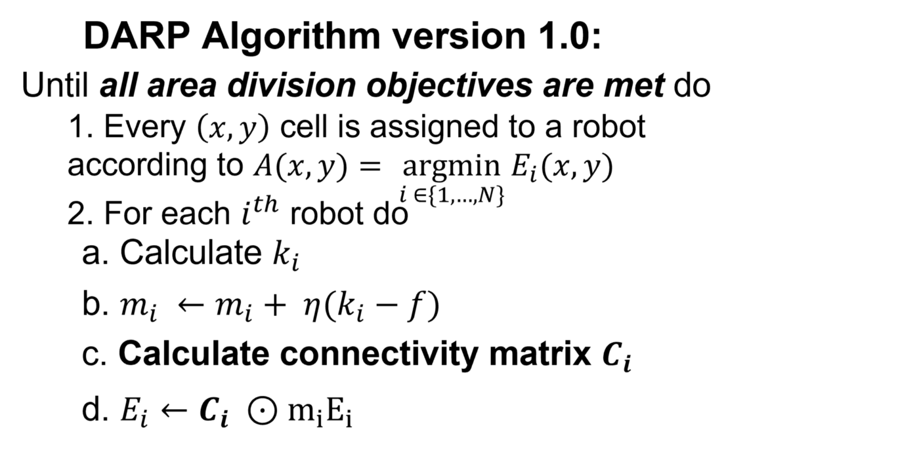
DARP 1.0
However, the algorithm claims that in most cases, this
will eventually help find the optimal solution.
More precisely, the DARP algorithm is capable of
escaping the local minima by temporarily violating
the condition about the connectivity of each ith robot
assignment matrix.
Afterwards, the algorithm gradually eliminates
unconnected areas by reinforcing the robot’s
evaluation Ei around the original
(the one that the robot lies in) subarea.

Slide 12
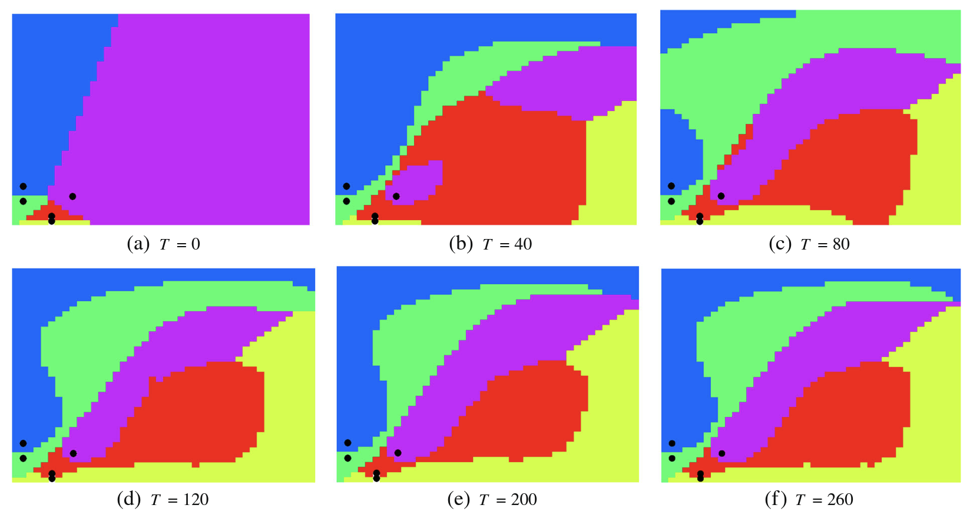

Slide 13
Challenges while implementing DARP
Failure of algorithm to converge due to close initial position of robots.
To tackle this problem we introduced a filter in the sense that only if all pairs of robots were separated a constant minimum distance will we try and find the optimal path using DARP.
In some other cases, even though the bots were far spaced, the algorithm was unable to converge.
If we give some leeway in terms of area covered by each bot the algorithm is able to converge.

